Slide 1
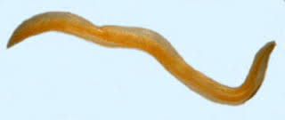
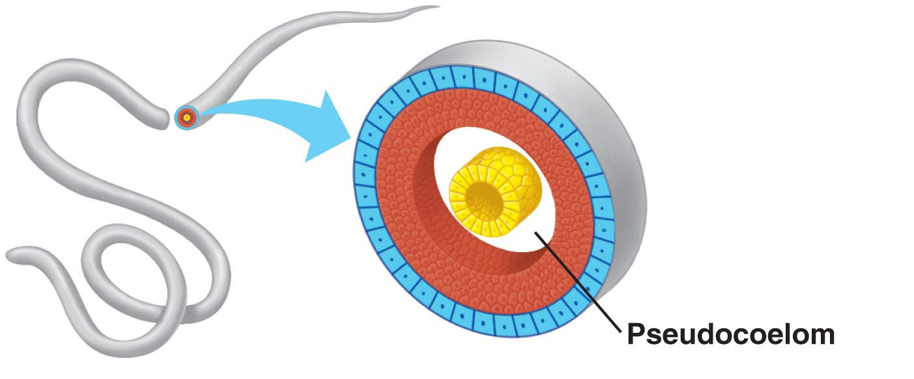
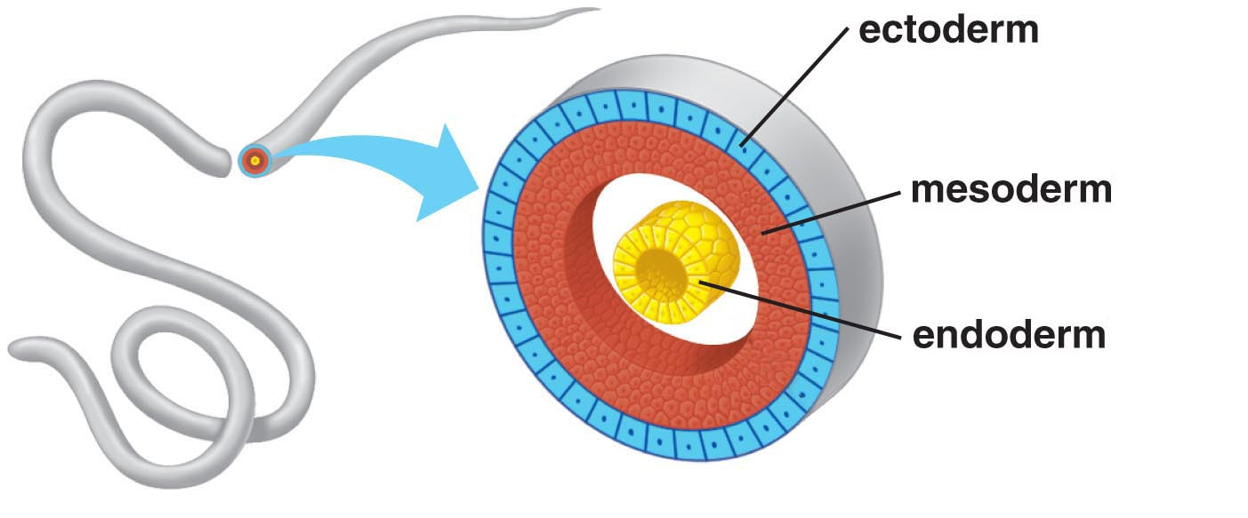
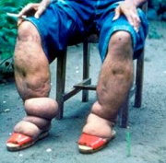
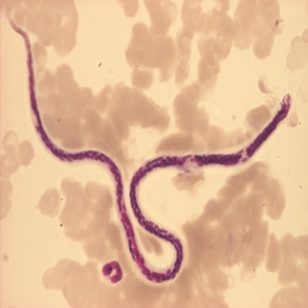
Nematoda
The nematode body is also bilaterally symmetrical and triploblastic
Nemat means round, cylindrical
However, the body is cylindrical rather than flattened.
There are tissues, but no real organs, although a sort of body cavity or a pseudocoelom, is present.
These are very familiar as parasitic worms causing diseases, such as the worms causing elephantiasis (filarial worms) or the worms in the intestines (roundworm or pineworms)
Some examples are ascaris and wuchereia.

Slide 2
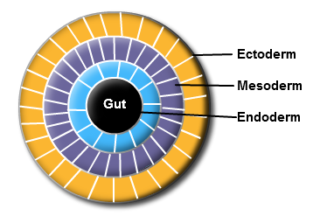
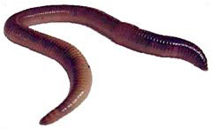
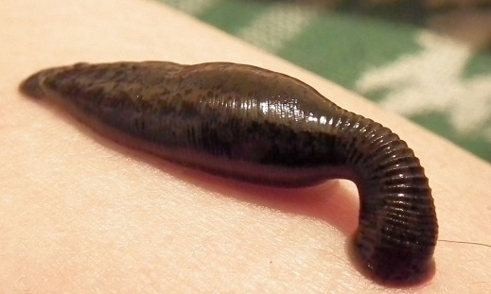
Annelida
Annelid animals are also bilaterally symmetrical and triploblastic
They have a true body cavity.
These animals are found in a variety of habitats-fresh water, marine water as well as land.
Earthworms and leeches are familiar examples.

